Slide 1
Jenkins & Docker
The leading open source automation server, Jenkins provides hundreds of plugins to support building, deploying and automating any project.
What is Jenkins?
Jenkins is a self-contained, open source automation server which can be used to automate all sorts of tasks related to building, testing, and delivering or deploying software.
Jenkins can be installed through native system packages, Docker, or even run standalone by any machine with a Java Runtime Environment (JRE) installed.

Slide 2
Installing Docker Using
Go to aws and launch redhat instance allow ports as we need..
Login ur account as a root user
yum update –y
dnf config-manager --add-repo=https://download.docker.com/linux/centos/docker-ce.repo
[root@docker-ce ~]# dnf list docker-ce Available Packages docker-ce.x86_64 3:19.03.5-3.el7 docker-ce-stable [root@docker-ce
To install the latest version: dnf install docker-ce --nobest –y
systemctl start docker
systemctl enable docker
[root@ip-172-31-13-145 ~]# docker --version
Docker version 19.03.11, build 42e35e61f3
To check docker correctly installed or not using
docker run hello-world
Refrence url: https://www.linuxtechi.com/install-docker-ce-centos-8-rhel-8/

Slide 3
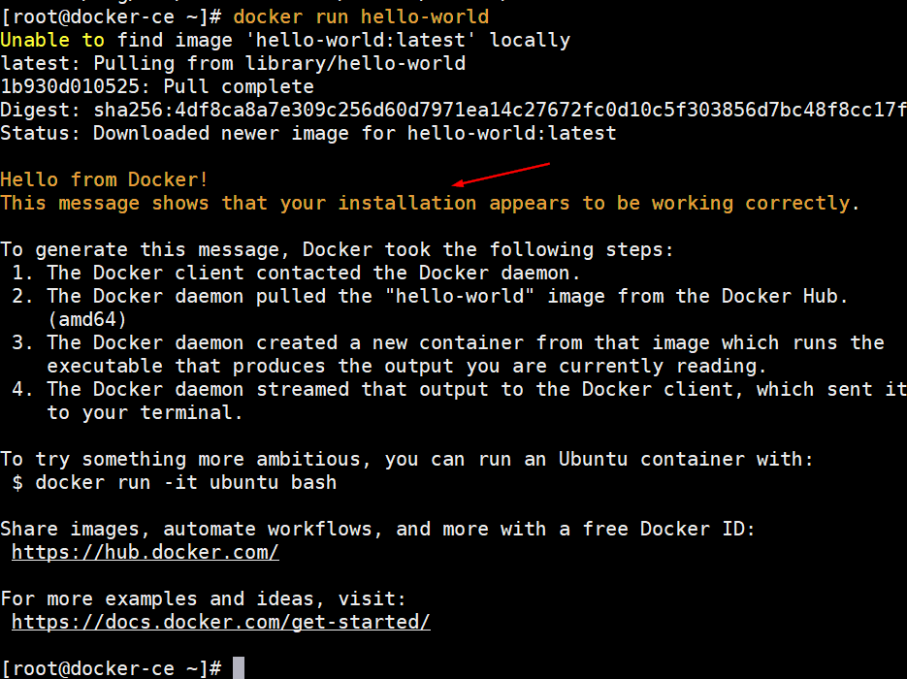

Slide 4
Install Docker Compose
Note: Docker should be start and enabled.(below steps must be u install with sudo commands otherwise compose not install
dnf install curl
sudo curl -L "https://github.com/docker/compose/releases/download/1.26.0/docker-compose-$(uname -s)-$(uname -m)" -o /usr/local/bin/docker-compose
To give permisson to docker compose file
sudo chmod +x /usr/local/bin/docker-compose
sudo ln -s /usr/local/bin/docker-compose /usr/bin/docker-compose
$ docker-compose --version
docker-compose version 1.26.0, build 1110ad01
For Reference:
https://docs.docker.com/compose/install/

Slide 5
Download jenkins with docker image
docker pull jenkins/jenkins
To check how many images are present in docker:
docker images
To check where docker is located : docker info | grep -i root
cd /home/
mkdir jenkins
mkdir jenkins-data
cd jenkins-data
pwd (/home/jenkins/jenkins-data)

Slide 6
Docker compose file
cd jenkins-data : vi docker-compose.yml
vi docker-composer.yml
version: '3'
services:
jenkins:
image: jenkins/jenkins
ports:
- 8080:8080
volumes:
- $PWD/jenkins_home:/var/jenkins_home
networks:
- net
networks:
net:

Slide 7
continue
mkdir jenkins_home
echo $pwd
echo $PWD/jenkins_home/
sudo chown 1000:1000 jenkins_home -R
(to run the docker file)- docker-compose up –d
Creating network "jenkins-data_net" with the default driver
Creating jenkins-data_jenkins_1 ... Done
Output will be above way will be there.
Now type docker ps u will see an image like jenkins/jenkins

Slide 8
Run jenkins with portno:8080
Before going to start and enter portno 8080:
We need jenkins admin password to start the jenkins
cd /home/jenkins/jenkins-data/jenkins_home/secrets
cat initialAdminPassword (copy the password and paste in ip:8080) url:
Click on install plugin go and create username and password
Start using jenkins
Welcome to jenkins (admin/admin@123)

Slide 9
Docker Compose commands (jenkins-data)
docker-compose stop (to stop container ex: jenkins will stop)
docker-compose start (to start container ex: jenkins will start)
docker-compose restart jenkins (to restart container ex: jenkins will start)
docker-compose down (it will delete all the complete containers 4 m docker)
docker-compose up –d (to run the composer containers)

Slide 10
Jenkins rhel8 aws installation
yum update -y
sudo yum install java-1.8.0-openjdk-devel
which java
cd /bin
ls
which java
ls -la | grep java
cd
java -version
curl --silent --location http://pkg.jenkins-ci.org/redhat-stable/jenkins.repo | sudo tee /etc/yum.repos.d/jenkins.repo
sudo rpm --import https://jenkins-ci.org/redhat/jenkins-ci.org.key
yum -y install jenkins
systemctl status jenkins
systemctl start jenkins
systemctl status jenkins
systemctl enable jenkins
cat /var/lib/jenkins/secrets/initialAdminPassword

Slide 11
Jenkins Dashboard
Create a job → new item → free style project(give name) → ok → build (Execute sheel) echo hello world → apply/save.-→ build now.→success console output
Hello world will be displayed.
Go to putty run below commands to login docker container
. docker run -it -d jenkins/jenkins (image name)
It will give long id paste that id in below command
. docker exec -it 5534ed52b63f22c41b8120e7335d677d2a53b70843929f4787c5e07d38214cb5 bash

Slide 12
Continue-
Login into shell script of container of docker
jenkins@5534ed52b63f:/$ date
Mon Jun 8 20:41:43 UTC 2020
Jenkins execute shell:
name=rajesh
echo "hello , $name. data & time is $(date)"
Build now (success go to console output).
Redirects to job output
name=rajesh
echo "hello , $name. data & time is $(date)" > /tmp/info

Slide 13
Job output redirect
In putty run ur container and see (redirect job output with in a container )
jenkins@4c4dc4c4b01e:/$ cat /tmp/info
hello , rajesh. data & time is Tue Jun 9 21:02:25 UTC 2020
Learn execute bash script from jenkins
vi script.sh
#!/bin/bash
NAME=$1
LAST=$2
echo "hello ,$NAME $LAST”
To execute : chmod +x filename and after run : ./script.sh raj singam

Slide 14
Add parameter to job
Configure of job general this project is parametrized → add parameter->string (name : firstname , value: rajesh) →another sting paramter-> (name : secondname , value: singamsetty).
Build → execute shell (echo "heeloo ,$firstname .$secondname ”) + save and build
choice parameter we have select any option to build.
Go to putty script.sh file
if [ "$SHOW" = "true" ]; then
echo "hello ,$NAME $LAST"
else
echo -e "please check the mark"
fi
To run script file : ./script.sh raj singam true (above putty what we did do in jenkins

Slide 15
Jenkins boolen parameter
Along with first name and last name take boolen ->name :show & default value will in checkmode.
Build : /tmp/script.sh $firstname singam true
Build now.
Putty inside container must be
To copy from docker to container
docker cp script.sh jenkins:/tmp/script.sh

Slide 16
Jenkins & docker (part2)
cd /home/jenkins/jenkins-data/
mkdir centos7 and cd centos7
vi Dockerfile (paste the below code)
FROM centos
RUN yum -y install openssh-server (to run ssh server)
RUN useradd raj && \ (create a user add password)
echo "1234" | passwd raj --stdin && \
mkdir /home/raj/.ssh && \ (creating home directory)
chmod 700 /home/raj/.ssh (giving permissions 2 home)
:wq (for the saving a file)

Slide 17
continue
ssh-keygen -f remote_key (after press 3 times enter)
ll or ls to see the what are the files are created in centos folder.
Now public key and private key both were created
Now we are going to make connection using ssh (public key)
vi Dockerfile
RUN yum -y install openssh-server
RUN useradd raj && \
echo "1234" | passwd raj --stdin && \
mkdir /home/raj/.ssh && \
chmod 700 /home/raj/.ssh
Copy

